Slide 1
Library Management System (Group 2)
Ahmed Fayez
Abanoub Awad
Shreekrishna ban

Slide 2
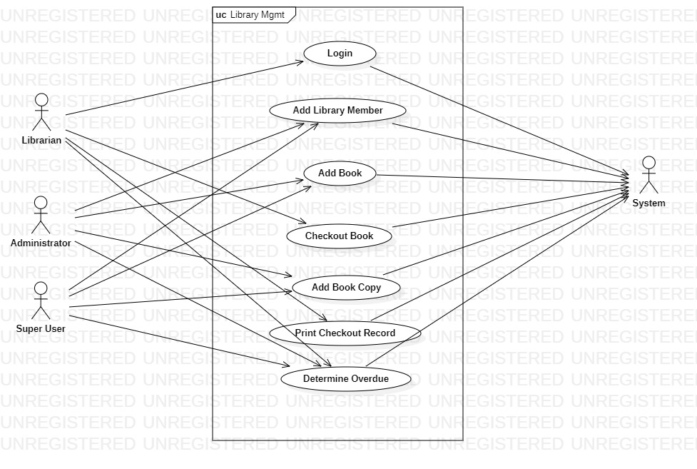
Use Case

Slide 3
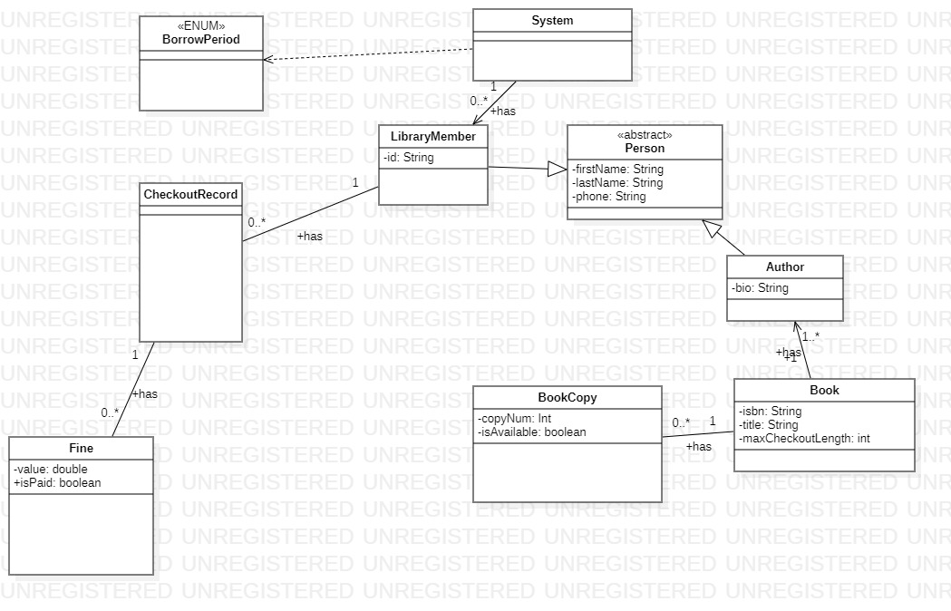
Checkout class diagram

Slide 4
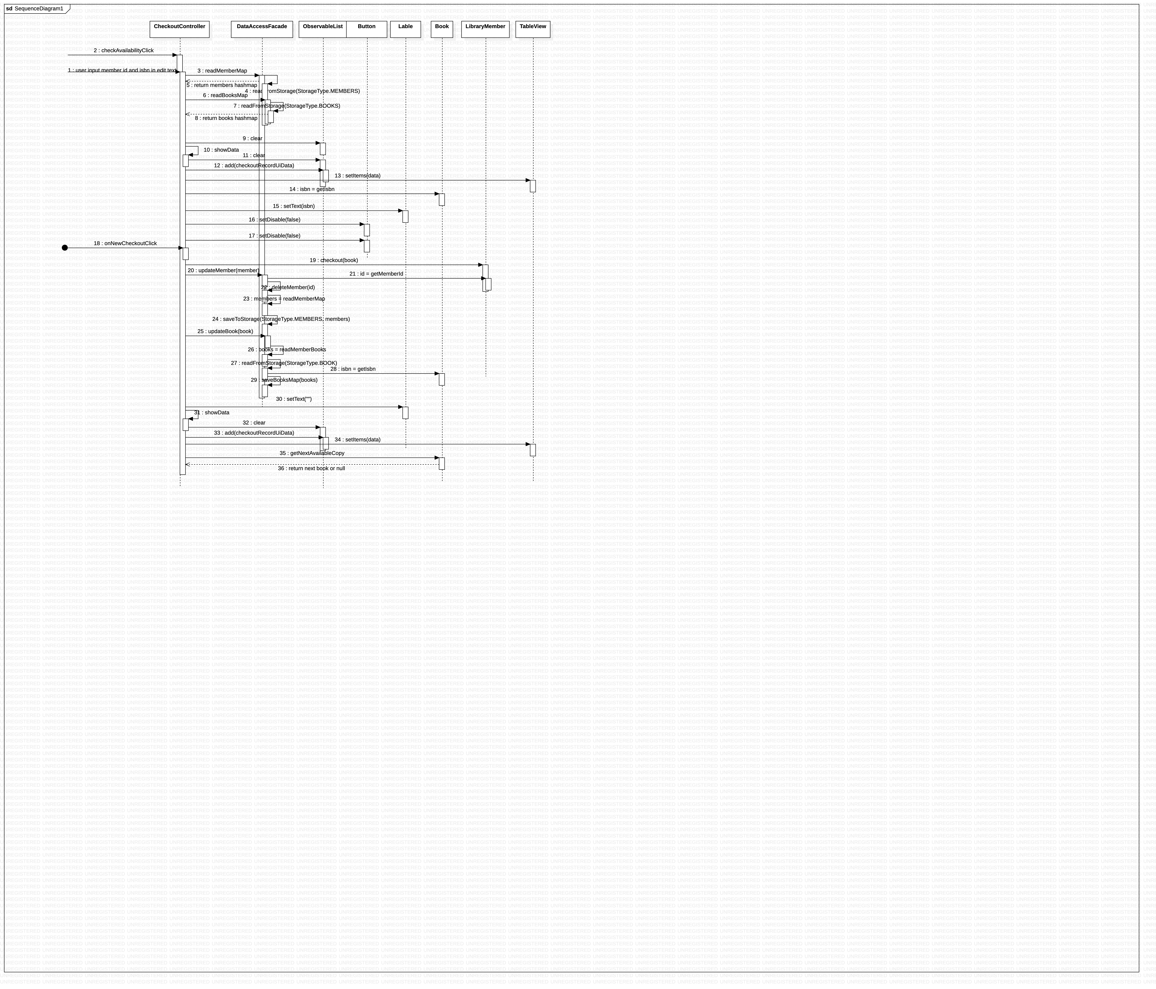
Checkout Book (Sequence)

Slide 5
UI Validation
UI View Permission - A Librarian can only see Book checkout screen (Book availability, overdue & checkout records.
An admin can only see Book tab (Book addition) & BookCopy tab (For a copy of book)
Data validation - Every book is identified by ISBN which needs to be unique & all member details including addresses are mandatory.
An active member with an active book checkout cannot be deleted and rest can be.
A copy of book gets added automatically once we add a book & we can add multiple copies later.

Slide 6
Extra use cases
Member checkout record - A members checkout record can be viewed in a console.
Overdue record - A record of any member exceeding defined return date can be viewed within the application.

Slide 7
SCI Knowledge
When people move to a culture, they naturally carry their own background and life experiences with them so does an admin & a librarian in this application while advancing their role to have both is a cultural adaptability.
As we’ve been going through the UML diagram first all the way to completion of project after feedbacks, All the steps could be mapped to 5 stages of changes from pre-contemplation to the maintenance & fixing.

